Slide 1
Data Wizards
Analyzing the Impact of Vanguard’s new modern UI
Franklin Ledesma and Ricardo Torres

Slide 2
Contents of Presentation
Introduction | 3
Data Overview | 4 - 5
Exploratory Data Analysis (EDA) | 6 - 7 - 8
Performance Metrics | 9 - 10
Hypothesis Testing | 11 - 12 - 13
Experiment Evaluation | 14
Tableau Visualizations | 15
Teamwork & Project Management | 16
Challenges & Learnings | 17
Conclusion | 18

Slide 3

Introduction
Vanguard, a leading investment management company renowned for its client-centric approach
We were tasked to determine whether a more intuitive and modern UI could make the online process smoother and more efficient
A/B test
Control Group: Clients interacted with Vanguard's traditional online process.
Test Group: Clients experienced the new, enhanced online process.
Critical question:
Did the new UI lead to a smoother, more user-friendly experience?

Slide 4
Data Overview
Demographic data
Digital footprints (Control group)
Experiment Roster (Test group)
Contains demographic and personal information about our clients.
A detailed trace of client interactions online using the old UI
Trace of the client interactions using the new modern UI

Slide 5
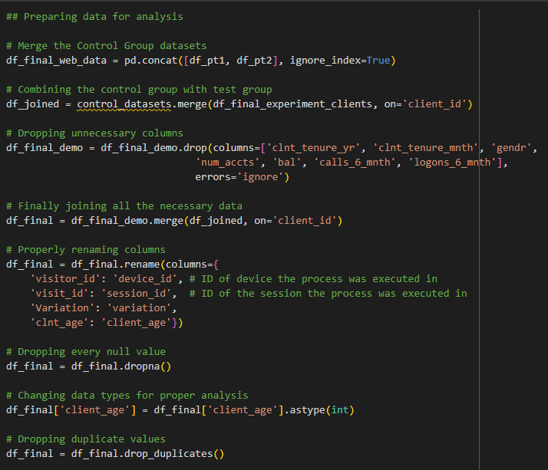
Data Overview
The digital footprint data sets were merged.
Useless columns were removed.
Columns were properly renamed.
Columns with null values and duplicates were removed.
Data types were properly converted.

Slide 6
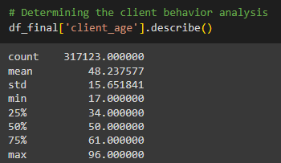
Exploratory Data Analysis (EDA)
Client behavior analysis
317,123 records remained for analysis
Average age was 48 years
The standard deviation was 16 years.
The range was 79 years with indicates a huge distribution.

Slide 7
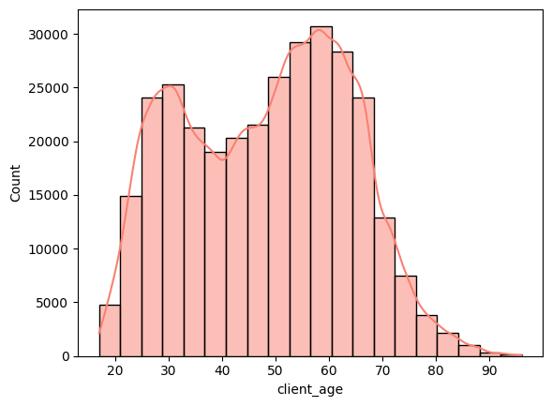
Exploratory Data Analysis (EDA)
Age distribution
It looks like most of Vanguards clients are in their late 50s, but a considerate amount are in their late 20s.
This might be good input for determining the target audience.

Slide 8
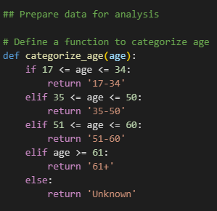
Exploratory Data Analysis (EDA)
This code prepares the data for analysis by categorizing the clients' ages into defined age groups.
The age categories were selected based on the data's four quartiles. Each category represents 25% of the entire age distribution of the clients.

Slide 9

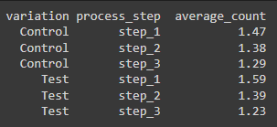
Performance Metrics
We used two main KPIs to determine performance differences:
Completion Rate: The proportion of users who completed the process (5 unique steps).
Repeated Step Count: The average number of times a client repeated a step in the process. We only took into consideration the middle steps because we thought the ‘start’ and ‘confirm’ steps were easy to go through.
= 1.38
= 1.40

Slide 10
Hypothesis Testing
Main analysis
Null- The test group (new UI) does not have a significantly better completion rate compared to the control group (existing UI).
Alternate- The test group (new UI) does have a significantly better completion rate compared to the control group (existing UI).
Null- The test group does not have significantly less repeated steps compared to the control group.
Alternate- The test group does have significantly less repeated steps compared to the control group.

Slide 11
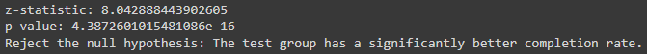
Hypothesis Testing Conclusions
Main Analysis:
Completion Rate (Two-Proportion Z-Test)
Repeated Step Count (Two-Sample T-Test)

Slide 12
Experiment Evaluation
Randomization
Clients were divided into two groups: Control (traditional UI) and Test (new UI).
Duration
The experiment was conducted from 3/15/2017 to 6/20/2017, spanning approximately three months.
Potential Biases
Selection Bias
Behavioral Bias
Technological Bias
Potential Useful Data
Demographic Data
Income Levels
Geographic Location
Help Requests

Slide 13

Tableau Visuals

Slide 14

Teamwork & Project Management
Mutual collaboration all throughout
Zoom Breakout Room calls
Templated Trello board
We aligned on the project's logic and performance metrics before delving into analysis
Using Python and SQL, we progressed through the project phases as a team
Only individual tasks were the Tableau visualizations and preparation of the presentation

Slide 15
Challenges & Learnings
Challenges / Key points:
Franklin:
Identify the clients that complete the test
Segment the data per Age
Learnings:
Franklin:
Organize the ideas and the scripts, tableau visuals
Ricardo:
The Hypothesis testing
After-hour work responsibilities
Ricardo:
Organize the logic and ideas first and then explore data

Slide 16
Conclusions
A significant Improvement in Completion Rate with the New UI
No Significant Reduction in Repeated Steps
Younger clients demonstrated better performance with the new process.
In contrast, the oldest clients performed the worst, with lower completion rates and more repeated steps.
Step 1 was identified as the most frequently repeated step, although not by a significant margin.

Slide 17
Recommendations
Enhance Intermediate Steps:
Since the repeated step count did not decrease significantly, consider refining the intermediate steps to make them more intuitive and reduce the likelihood of users needing to repeat them. (This may vary per Age group see the provided to graph for details)
Targeted Usability Improvements for Older Clients:
Given the challenges faced by older clients, conduct targeted usability testing with this demographic to identify specific pain points. Tailoring the UI to be more senior-friendly, with clearer instructions and simpler navigation, could help improve their experience.
Continuous Monitoring and Iteration:
Continuously monitor user interactions and gather feedback to identify areas for ongoing improvement. Iterative testing and refinement will ensure that the UI continues to meet the evolving needs of Vanguard's clients.

Slide 18

Thanks for your attention!
Any questions?

